Slide 1
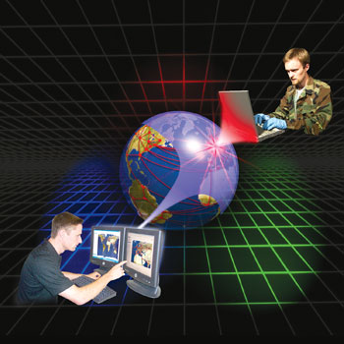
Achieving All-Hazards Threat & Risk Information Sharing and Federation
!
The conceptual model approach

Slide 2
What we have heard
Call to action from the highest levels of government
Threats to critical infrastructure
Insider threats
Blended attacks – the 70%
Counterintelligence & defense
Information as a national asset
All threats, all hazards
Understand your critical assets,. Costs of complexity, Change of processes
Threats to retail across cyber and physical
The challenge of securing complex systems
The challenges of situational awareness across domains
All source threats to industry and government
Importance of secure and trusted supply chains
Regular reports of cyber and physical attacks
Patterns in massive data at extreme speeds
Security is a team sport
So what can we do about it?

Slide 3
Goal: An integrating framework
Cyber
Crime
Terrorism
Critical Infrastructure
Disasters
Integrating Framework for Threats and Risks
Sharing & Analytics
Sharing & Analytics
Sharing & Analytics
Sharing & Analytics
Sharing & Analytics
An integrating framework that helps us deal with all aspects of a risk or incident
A federation of risk and threat information sharing and analytics capabilities

Slide 4
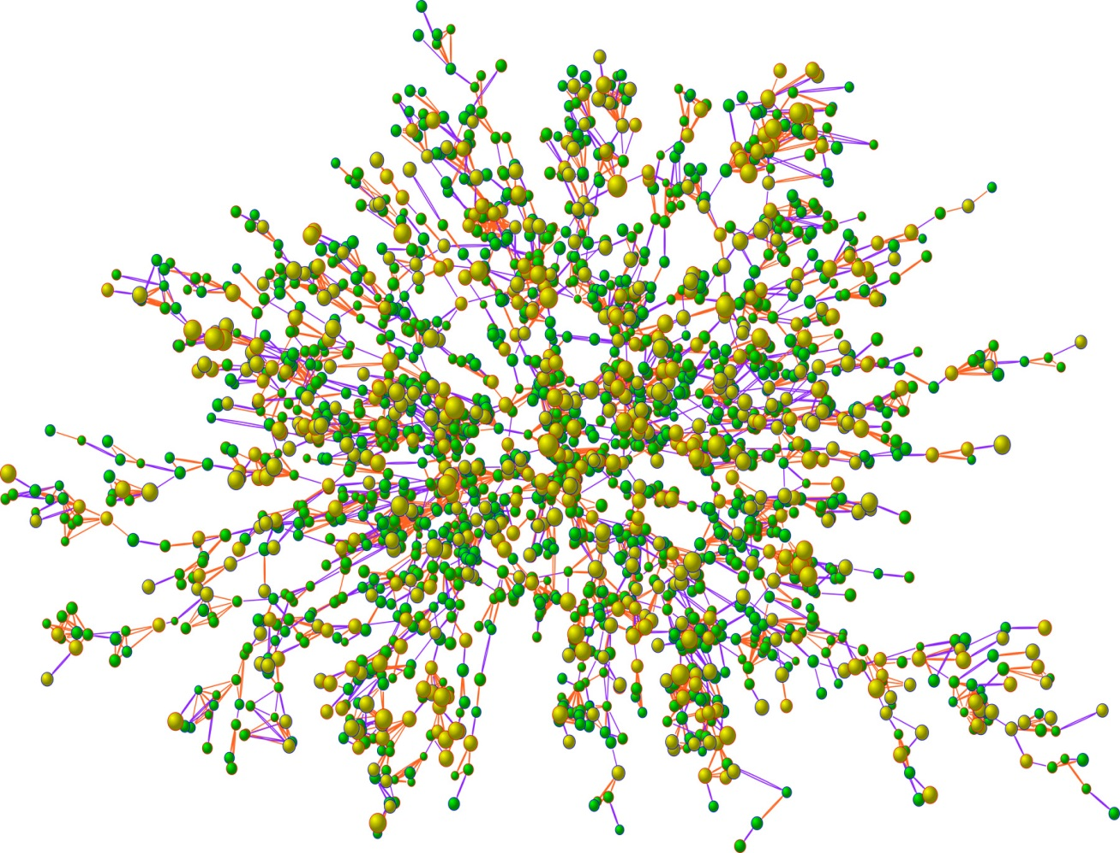
Approach to integrating domains
Construct a conceptual model informed by existing domains, research and best practices
This conceptual model is independent of specific data structures, technologies and terminologies
Define mapping models between the conceptual model and purpose/organizational schema
Make both models sufficiently precise that they can drive automated bridging between any mapped schema
Use cases focuses scope and detail
Cyber
Terrorism
Cyber
Cyber
Cyber
Health
Map/Bridge
Map/Bridge
Map/Bridge
Conceptual Models
Map/Bridge
Map/Bridge
Criminal
Cyber
Criminal
Infrastructure

Slide 5
At the technical level
Define mapping rules between the conceptual models and various technology/domain specific models
Automation can then federate information from multiple source or translate between them
Of course translation is limited to the concepts in common!
Conceptual models can be extended for additional concepts and mappings – it is an open system
Cyber
NIEM
Cyber
Cyber
STIX
HL7
Map/Bridge
Map/Bridge
Map/Bridge
Conceptual Models
Map/Bridge
Map/Bridge
Criminal
Cyber
EDXL
Others

Slide 6

Concepts at the core
The core to any communications or analysis is shared concepts
Given a foundation in concepts there is a need for shared vocabulary and syntax – but there is a lot of variation in vocabulary and syntax
The concepts are captured in a model, and then related to different vocabularies and syntaxes
Concepts are about real world things, not data or technology
Of course data then represents the concepts which can be manipulated by technology

Slide 7
Core Concept: Comprehending Planned and Unplanned Threats
“All hazards” include man-made and natural disasters/system failures
There is not always an actor involved (e.g. hurricane, system malfunction)
Intentional threat actors are not the only source of threats
Non-malicious actors may constitute significant threat (e.g. spear-phishing victim, power plant operator)
Defenders (e.g. system admins, law enforcement, medical staff) are also actors with defensive plans
Victims are actors as well

Slide 8

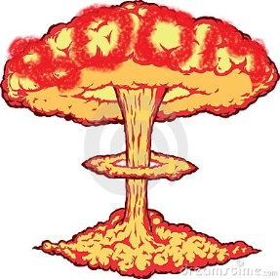


Intent
Threat Actor
Plan
Capability
Act
Potential Effect
Real World Effect
Vulnerability
Risk
Threat
Incident
Consequence
Impact on Objectives
Stakeholder
Potential Event
Actual Event
Natural event or System failure

Slide 9
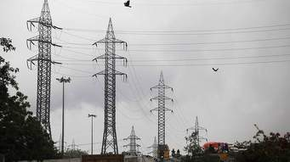

Core Concept: Attacker/Defender Symmetry
Attack perspective:
Defender: Attackers/hazards are threats
Attacker: Targets are opportunities
Defense perspective:
Attacker: Successful defense is a threat to the intentions/objectives
Defender: Maintaining effective defensive posture is an opportunity
Threat vs. Opportunity is in the eye of the emoticon – it is not sufficient to create static classifications
Opportunity!
Capability to disrupt the power grid
Threat!
Notes:
One mans risk is another mans opportunity
The same risk/threat/incident needs to be understood from very different perspectives
Classifying something as a risk/threat/incident or mitigation only makes sense with respect to how it impacts the objectives of some stakeholder. E.g “a risk of damage to the U.S. power grid impacting millions”.
The conceptual model supports this separation while mapping to structures that assume a particular perspective.

Slide 10
Example Scenario: Coordinated Power Grid Attack
Attack
Laptop with access credentials is stolen
Grid industrial control system is compromised in Cyber attack
Physical attack on substation disrupts power
Compromised system cascades failure
Physical infrastructure damaged
Potential Mitigations
Law enforcement recovers laptop
Compromise is recognized by Cyber defense, system is hardened
Law enforcement notified and arrests attackers
Preparation is identified and defense forces put in place
Real-time notification of systems going down initiates manual shutdown

Slide 11


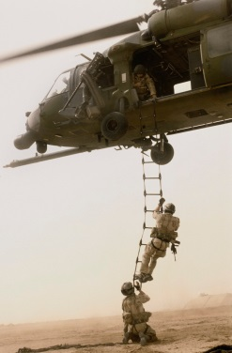



Cross-domain Information Flows
Suspicious Activity Report
NIEM
Incident
Arrest Report
STIX Incident
Tactical Response Unit
Fusion Center
Intelligence
Report
IT System Hardening
Manual Shutdown
Public CAP Warning

Slide 12

Example - Snowmageddon
In January 2015 Massachusetts faced the Hazard of major winter storms across the region. Potential Harm from blizzards and winter storms includes negative economic impact, limited road accessibility, restricted emergency management, non-availability of utility, property damage, personal injury and death, and more.
The onset of a winter storm or blizzard was predicted by the National Weather Service (NWS).

Slide 13
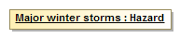
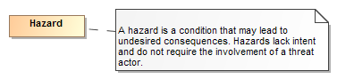
Example of structuring risk information
In January 2015 Massachusetts faced the Hazard of major winter storms across the region.
Is formalized as
Is defined by
A data syntax and vocabulary
Maps To
<drn:PotentialDanger>Major winter storms</drn:PotentialDanger>

Slide 14
Scope
Wide & shallow conceptual model generically covering threats and risks
Other risks (Out of scope)
Operational Threat & Risk Concepts
High level Cyber-threat/risk concepts
Law Enforcement / Emergency Management Concepts
Physical. Spectrum, facilities,
Probabilities, Forensic, Chemical, Biological, Medical, Nuclear, Military and Intelligence threats concepts
STIX/TAXII/Cybox
IODEF
SACM
ISO
NIST
Others…
NIEM Threat/Risk Representation
Other Risks
Systemic Risk
Credit Risk
Market Risk
Pension Risk
Reputation Risk
Liquidity Risk
Legal Risk
Project Management Risk
Legend
Normative
(Formal Specification)
NIEM Exchanges
EDXL / CAP
Others…
Other Inputs
In Scope with Limited Detail
Informative

Slide 15

Primary Use Cases
Data Format 1
Data Format 3
Threat / Risk
Data Broker
Data Format 2
Data Format 4
Data Source 2
Data Format 3
Data Source 1
Data Format 4
Threat / Risk
Federation / Analytics
New Knowledge

Slide 16
Why this is important
To make sense of data from many sources
To deliver information to secure supply chains
To allow diverse organizations to collaborate and share information
To protect critical assets and sensitive or private data
To provide threat and risk analytics across domains
Cyber and physical
Safety and security
Health, Intelligence, biological, retail, military, finance
Private and public sector– internationally

Slide 17
Example use cases
Protection of critical infrastructure through information sharing and analytics. Specific use cases for the electric grid (Duke Energy)
Large company understanding and acting on its threat/risk landscape
Fusion center “connecting the dots” by federating multiple data sources
California Governor’s Office of Emergency Services fusing BioWatch and other data for better decision making
Integration of STIX (Cyber) data with physical threats and risks for all-hazards
Retail Sector Point of Sales Attack
Securing the supply chain for Air Force avionics
Physical attack on Transformer Yields Cyber and Kinetic Effects
Threat to electronic healthcare records
DoD Information Sharing Portal
Federating information for evaluating the trust of individuals and organizations
Victim information compromise
Theft of laptop exposes credentials resulting in loss of confidential information
State Cybercrime Investigation
Aligning risk models along the dependencies between systems

Slide 18

It takes a community
Threat & Risk Information
Sharing Community
Leadership
Information
Sources
Policy
Standards
Tools &
Services
Information Analysts
& Consumers

Slide 19
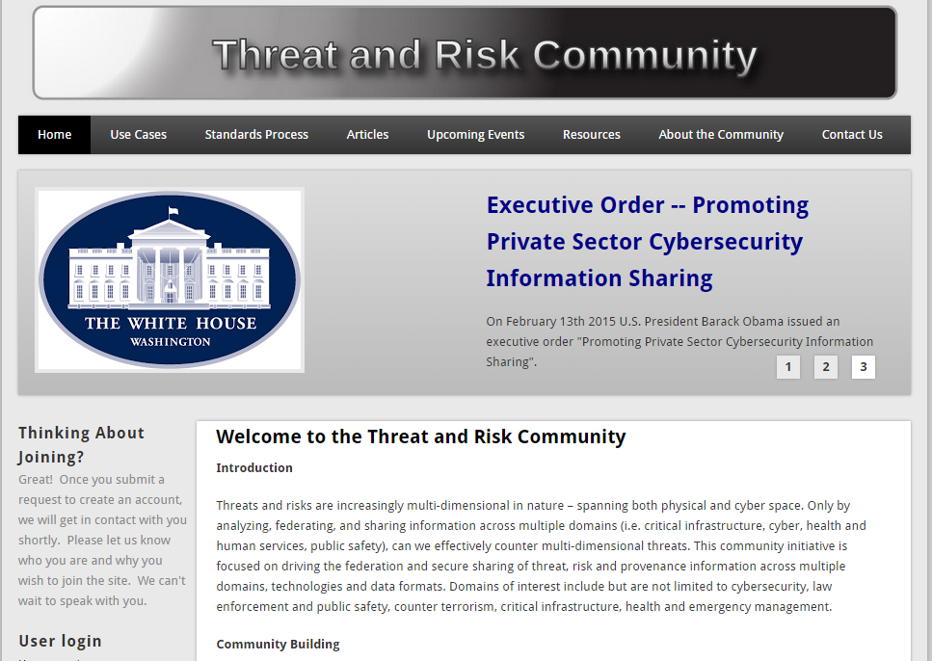
Community web site

Slide 20
Example of structuring risk information
In January 2015 Massachusetts faced the Hazard of major winter storms across the region.
Is formalized as
Is defined by
A data syntax and vocabulary
Maps To
<drn:PotentialDanger>Major winter storms</drn:PotentialDanger>

Slide 21
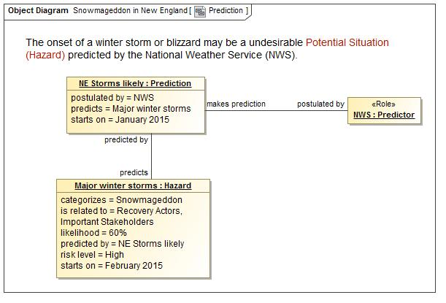
A Potential Storm? Who said this?

Slide 22
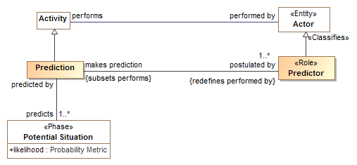
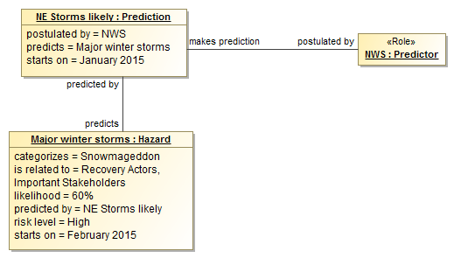
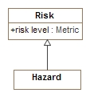
Real-world events relate to the concepts

Slide 23
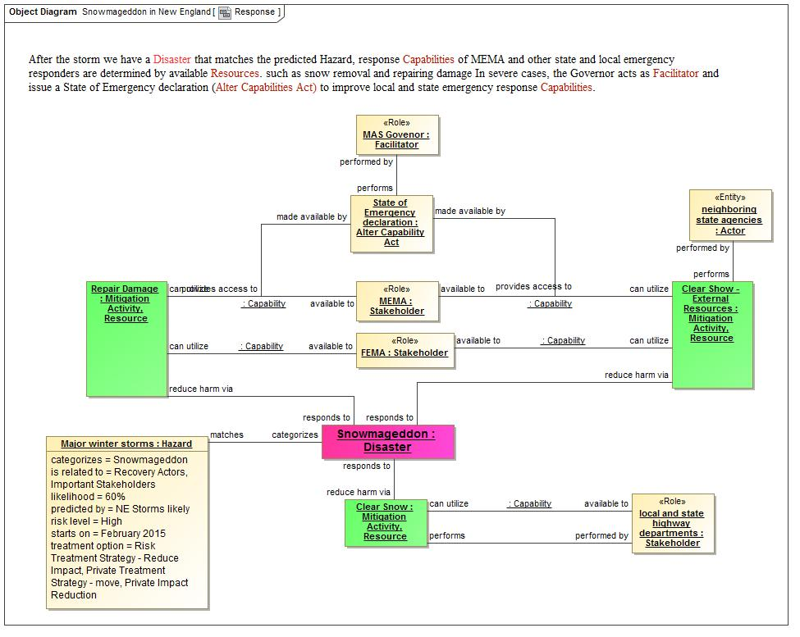
Response Concepts

Slide 24
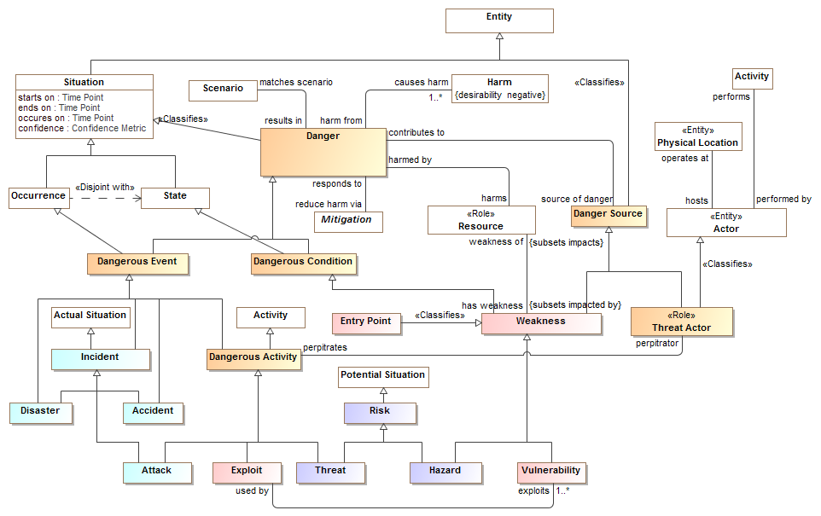
How concepts relate

Slide 25
Mapping

Slide 26
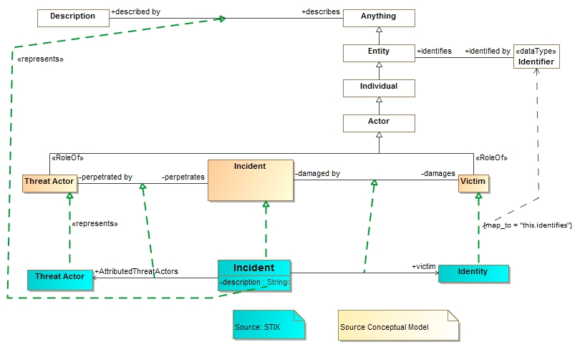
STIX Mapping fragment
Note: Complete mapping rules are more complex

Slide 27
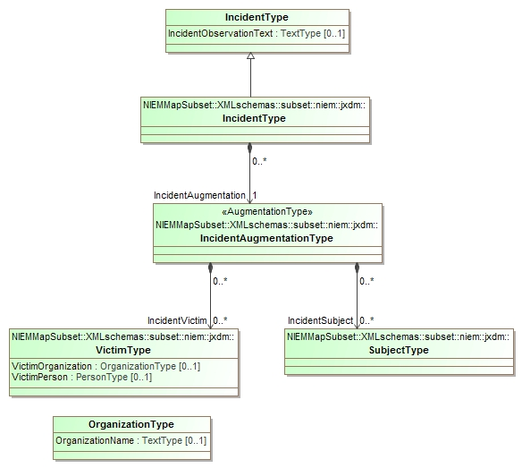
Corresponding NIEM Subset of interest
Multiple classes representing an incident due to the way NIEM segments domains

Slide 28
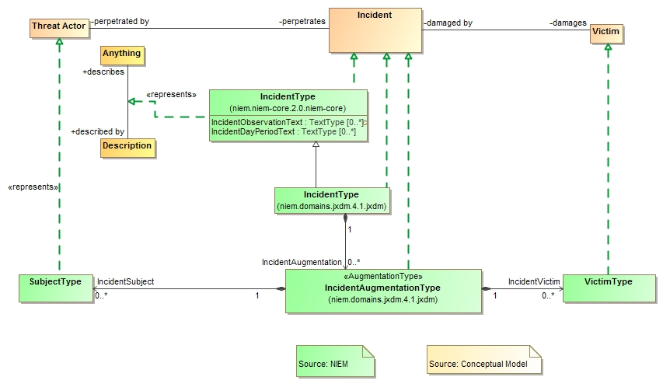
NIEM Mapping Fragment

Slide 29
Example STIX data
<stix:Incident id="example:incident-fd56fb34-af59-47b3-95cf-7baaaa53fe93" timestamp="2014-08-28T16:42:52.859547+00:00" xsi:type='incident:IncidentType' version="1.1.1">
<incident:Title>Breach of Canary Corp</incident:Title>
<incident:Time>
<incident:Incident_Discovery precision="second">2013-01-13T00:00:00</incident:Incident_Discovery>
</incident:Time>
<incident:Description>Intrusion into enterprise network</incident:Description>
<incident:Reporter>
<stixCommon:Description>The person who reported it</stixCommon:Description>
<stixCommon:Identity id="example:Identity-5db269cf-e603-4df9-ae8c-51ff295abfaa">
<stixCommon:Name>Sample Investigations, LLC</stixCommon:Name>
</stixCommon:Identity>
<stixCommon:Time>
<cyboxCommon:Produced_Time>2014-03-11T00:00:00</cyboxCommon:Produced_Time>
</stixCommon:Time>
</incident:Reporter>
<incident:Victim id="example:Identity-c85082f3-bc04-43c8-a000-e0c1d0f2c045">
<stixCommon:Name>Canary Corp</stixCommon:Name>
</incident:Victim>
<incident:Impact_Assessment>
<incident:Effects>
<incident:Effect xsi:type="stixVocabs:IncidentEffectVocab-1.0">Financial Loss</incident:Effect>
</incident:Effects>
</incident:Impact_Assessment>
<incident:Confidence timestamp="2014-08-28T16:42:52.859570+00:00">
<stixCommon:Value xsi:type="stixVocabs:HighMediumLowVocab-1.0">High</stixCommon:Value>
</incident:Confidence>
</stix:Incident>

Slide 30
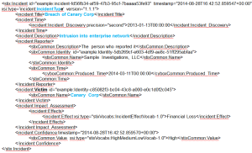
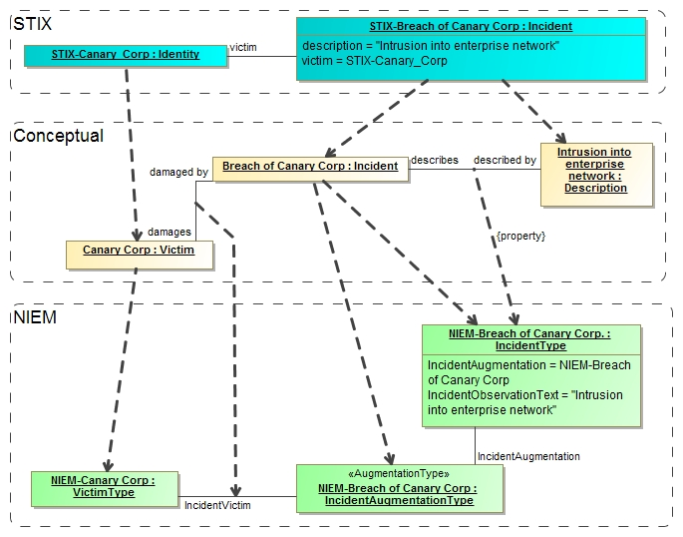
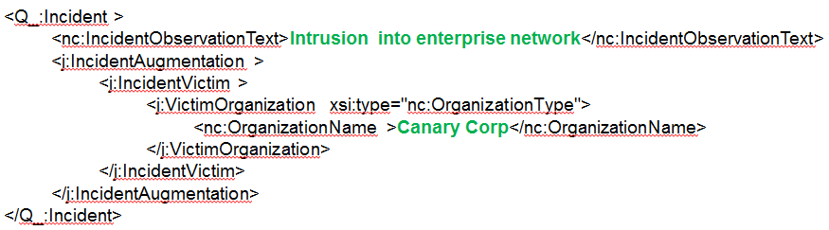
Notional Model Mapping Instances
STIX Data
Note: Conceptual instances are “virtual”, no actual instances are necessarily created.
NIEM Data

Slide 31
Derived NIEM Data
<Q_:Incident >
<nc:IncidentObservationText>Intrusion into enterprise network</nc:IncidentObservationText>
<j:IncidentAugmentation >
<j:IncidentVictim >
<j:VictimOrganization xsi:type="nc:OrganizationType">
<nc:OrganizationName>Canary Corp</nc:OrganizationName>
</j:VictimOrganization>
</j:IncidentVictim>
</j:IncidentAugmentation>
</Q_:Incident>
Note that only elements of interest that have a correspondence between STIX and NIEM are mapped. However, this kind of summary may be what is needed by, for example, law enforcement.

Slide 32
Threat / Risk and data
The threat risk specification does not create yet another data format
It maps to and from existing data, such as STIX, NIEM, EDXL and others
Remember – our goal is federation and interoperability across domains, disciplines and technologies.
Each concept we want to share or federate is mapped, but we do not try and map the details of interest to those “inside” the domain – they are fine where they are.

Slide 33

Implementation Patterns
Technology implementations make the specification real – create the capability
Multiple technologies could be used
Big data
Semantic Web
Ontologies
Rules
Information Brokers
Analytics Engines
Simulation Engines
Graph, XML and/or Relational Database
The standard does not limit the technologies used to implement it

Slide 34
Where are we
Conceptual Model
Synthesizes Input from NIEM, STIX, OGC and others
Multiple use cases
Results in a solid draft foundational model
Mappings
Mappings are in-progress
Most are information
STIX has early prototype
Specification
Draft initial specification is available on threatrisk.org
Initial proposals will be submitted to OMG in May 2015

Slide 35
OMG RFP Process Time Line
OMG TC Meeting
March 23rd 2015
OMG TC Meeting
June 18th 2015
OMG TC Meeting
Dec. 7th 2015
OMG TC Meeting
March 14th 2016
Issue RFP
Initial Submission
Revised Submission (May be multiples)
Draft Submission
Task Force, AB Vote
June 2014
March. 23rd
2015
May 18th
2015
Nov 9th
2015
March 14 2016
OMG TC Meeting
June, 2016
If passed, TC Vote Starts
TC Vote Completes
BoD Vote – Beta spec adopted
Finalization TF process
Finalization TF Final Specification
Final Review, votes, adoption
March 2016
May 2016
June 2016
Thru 2016
Late 2016
Late 2016

Slide 36
Who are we
Demandware
Model Driven Solutions
KDM Analytics, Inc.
LEADing practice, Inc.
RSA, The Security Division of EMC
U.S. Information Sharing Environment PMO
U.S. National Information Sharing Model (NIEM) PMO
U.S. Air force
U.S. Defense Security Services
California Public Safety

Slide 37
Join us!
We are an open community focused on sharing and federating cross-domain threat and risk information
Participate deeply or just follow and review
We welcome use cases, existing schema, models, data sources, data consumers, vendors…
Talk to us!
Or, see: http://www.threatrisk.org

Slide 38
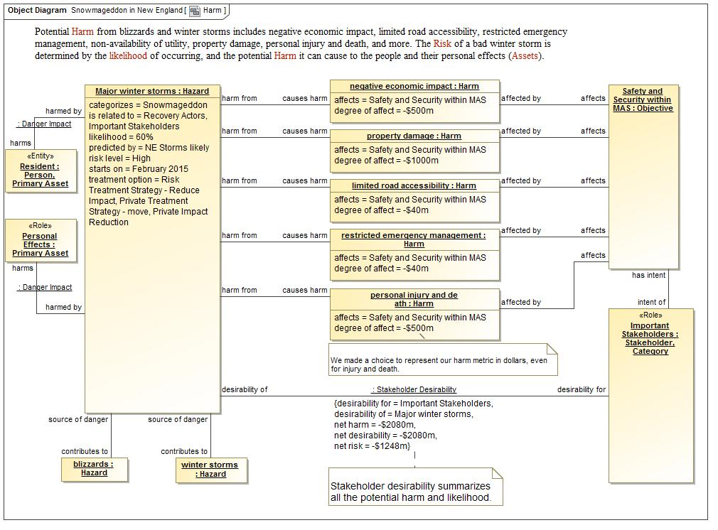
Each concept of our scenario is captured

Slide 39
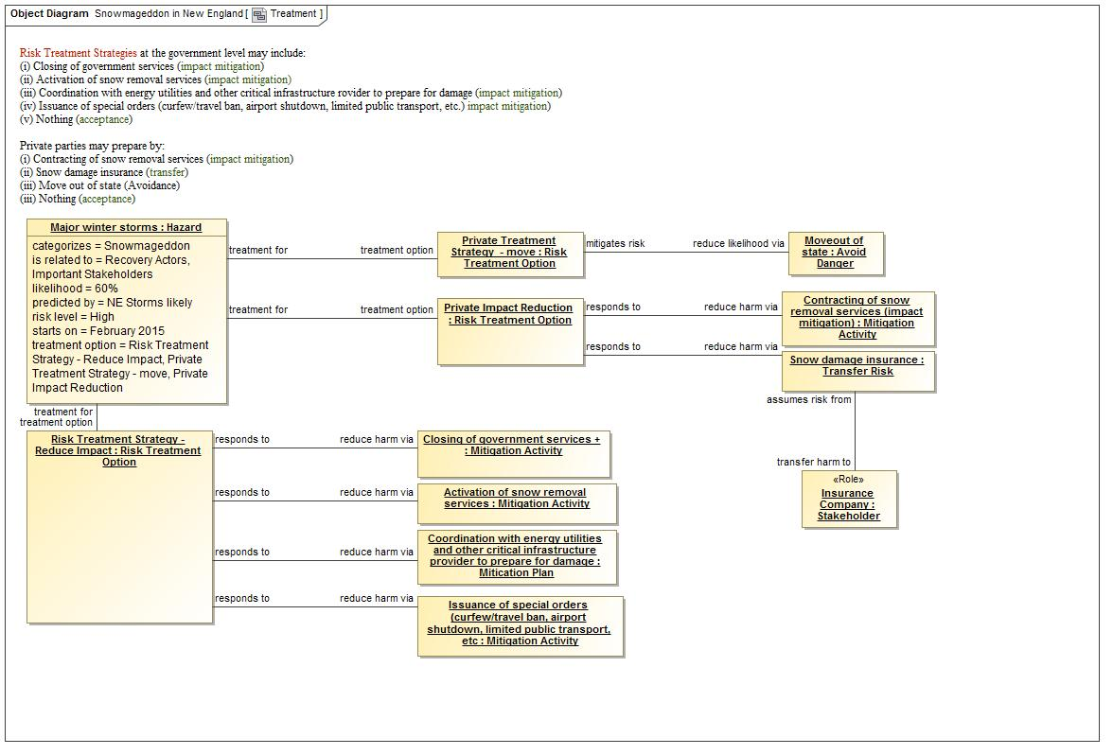
Treatment concepts

